Slide 1
The purpose of this slide is to fulfill the requirements for DSI 39, Project 2.
Group Name: The Colony
Members:
Jackie Seah
Li Cheng
Mei Qi
Yvonne Lim
Role: CPFB Data Science team
Audience: CPFB Senior Management
Problem Statement: With rising resale flat prices and record high prices such as the latest 4 room flat in Tiong Bahru at S$1.5mil. How can CPF board assist potential homeowners to plan their housing finances better?

Slide 2

Analysis and
Prediction of
HDB Resale Flat Price
CPFB Senior Management Meeting
15 Sep 2023

Slide 3

Meeting Agenda
01
HDB RESALE FLAT LANDSCAPE
02
IMPORTANCE OF KNOWING RESALE PRICE
03
PREDICTIVE MODELLING
04
RECOMMENDATIONS

Slide 4
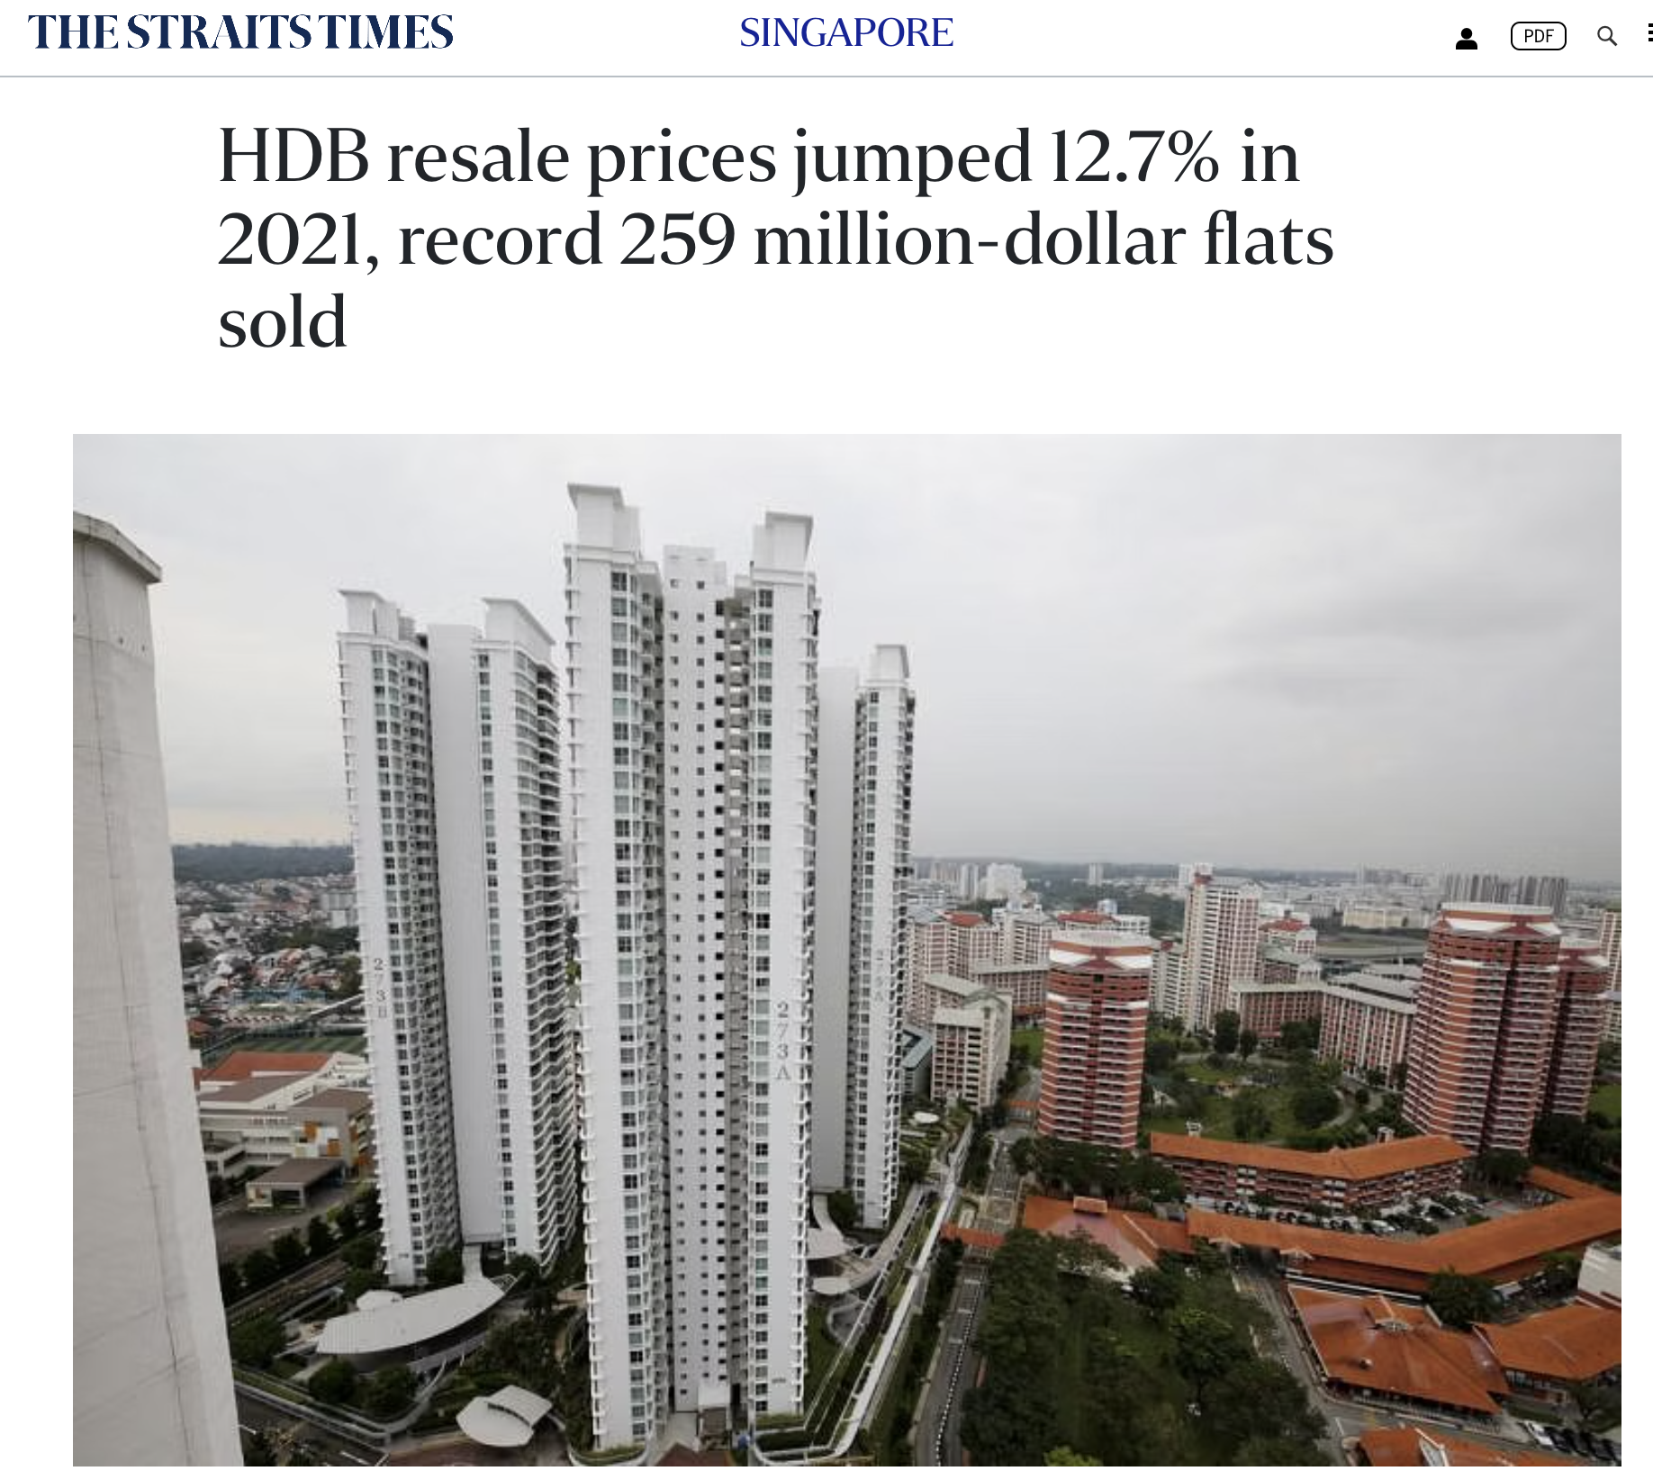
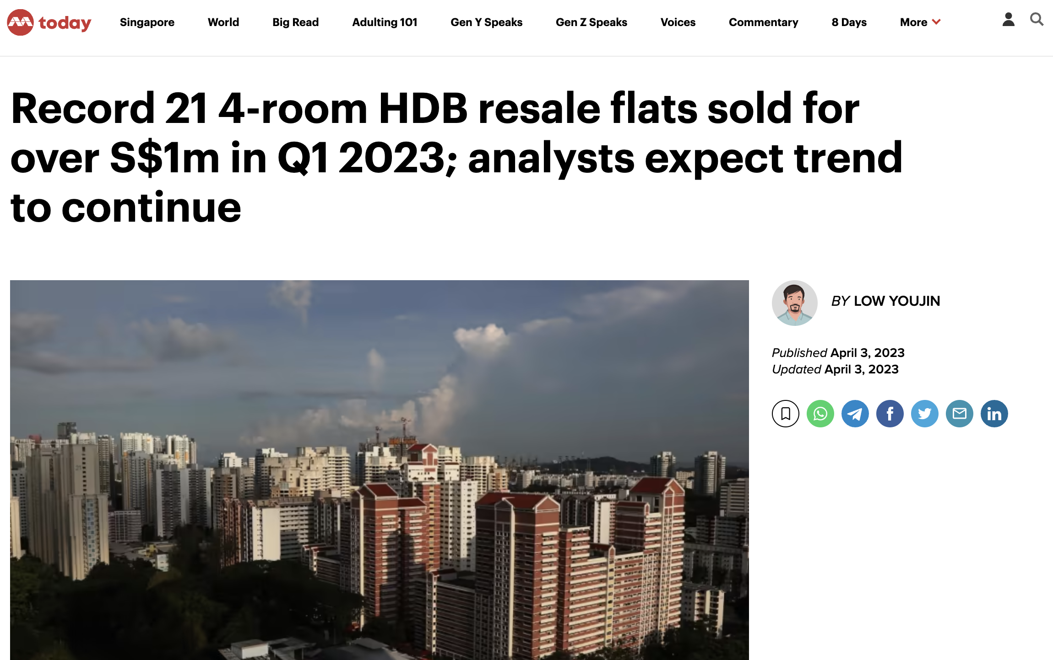
HDB Resale Prices are at a Record High
Record of 259 million-dollar HDB resale flats in 2021!
More than 20 4room HDB resale flats sold over S$1 million!
Source:
todayonline.com/singapore/record-4-room-resale-flats-2143666
Source:
https://www.straitstimes.com/singapore/housing/hdb-resale-prices-jumped-127-in-2021-record-259-million-dollar-flats-sold
Notes:
The resale flat prices are increasing over the years and we have a record high of 259 million dollar HDB resale flats in 2021. In Q1 2023, there are already 21 4 room resale flats sold over $1m!

Slide 5
HDB Resale Flat Landscape
56%
40%
$3.9 Bn
of Singaporeans who are in their 20s are worried that they cannot afford a home.
of Singaporeans are worried that they will not be able to pay their monthly instalments for their mortgage.
CPF monies are used by homeowners to pay their housing loan instalments in 2022.
Source:
https://www.ocbc.com/group/financial-wellness-index/understand-the-index.html
Notes:
According to an annual wellness survey by OCBC, 56 percent of Singaporeans who are in their 20s are worried that they cannot afford a home.

Slide 6
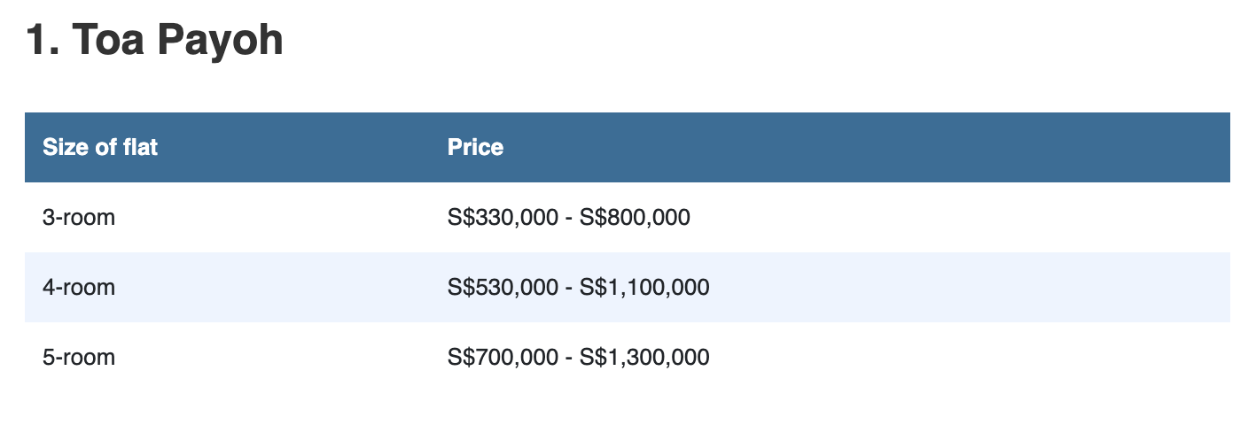
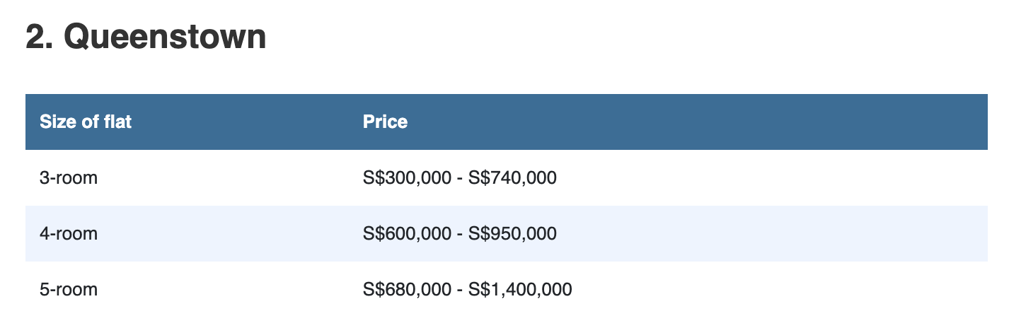
Available data on HDB resale prices are limited
Estimated HDB resale prices found online varied significantly from
$500k - $700k !
Source:
https://www.singsaver.com.sg/blog/the-cheapest-and-most-expensive-hdb-estates-for-resale-flats

Slide 7


How can our agency assist
potential homeowners to plan
their housing finances better?
Notes:
With rising resale flat prices and record high prices, it’s no wonder that affordable public housing has become a concern to new homeowners.
How can CPF board assist potential homeowners to plan their housing finances better?
This project explores the factors behind HDB resale prices in Singapore using data science methologies and how our predictive resale price model can help homeowners predict their desired resale flats price and make informed decisions before their purchase

Slide 8




Knowing the price of the HDB resale flat that they intend to purchase, aspiring homeowners can better plan their finances
AMOUNT OF CPF
SAVINGS YOU CAN USE
HOUSING
LOAN AMOUNT
YOU CAN GET
Source:
https://www.propertyguru.com.sg/property-guides/hdb-valuation-sales-12882
Notes:
The resale price affects the amount of CPF savings you can use, and the housing loan amount you can use.

Slide 9


Project Objective
Fast and High
Accuracy
Intuitive &
Easy to Use
We aim to deploy a HDB resale price calculator that is reliable and accurate (r² > 0.8, RMSE < $50k) which is intuitive and easy (minimal number of interpretable features) for home owners to use.
RMSE is the measure of the differences between values (sample or population values) predicted by a model or an estimator and the values observed
Coefficient of determination, R² is the proportion of the variation in the dependent variable that is predictable from the independent variable(s)
Notes:
Yvonne stop here

Slide 10

HOW DO WE GET A USER-FRIENDLY & ACCURATE CALCULATOR?
Notes:
Yvvone ends here.

Slide 11
Methodology for Price Prediction
Understanding the Dataset
76 potential features* to predict resale price
Data period: Mar 2012 - Apr 2021
Principle of Feature* Selection
High correlation with resale price (e.g., larger floor area leads to higher price)
Literature Review & Domain expertise
High variability (i.e., feature values that changes with the resale price)
*Note:
Feature = Potential factor that will affect the HDB resale price
Notes:
Li Cheng starts here.
The methodology for our prediction involves understanding our dataset, which include knowing what are the available features in the data as well as the period of data that we have for the prediction. From the dataset, there were 76 potential features that can help us predict resale price, and the period of data is close to a decade for our analysis.
We also adhered to three main principles for selection of useful features for our modelling, which are 1) including numeric features that show high correlation with resale price, 2) relying on literature review to include features not found in our original dataset, and lastly identifying features with a wide range of values for inclusion in our modelling process.

Slide 12
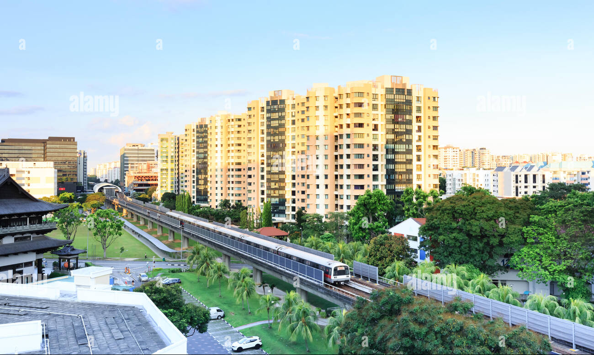
Main categories of features affecting resale price
1. Flat Attributes
3. Amenities
2. Location
4. Accessibility
Notes:
Broadly, the available features in the dataset can be categorised into 4 main groups, 1) Flat attributes like the floor area and flat type , 2) Location such as the postal area of the flat, 3) Amenities that are near the flat, and lastly accessibility of the flat from the public transport system.

Slide 13
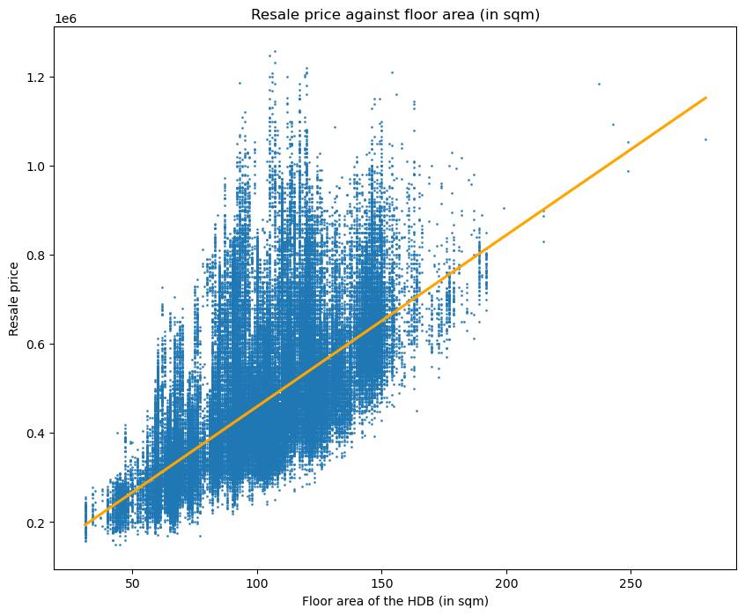
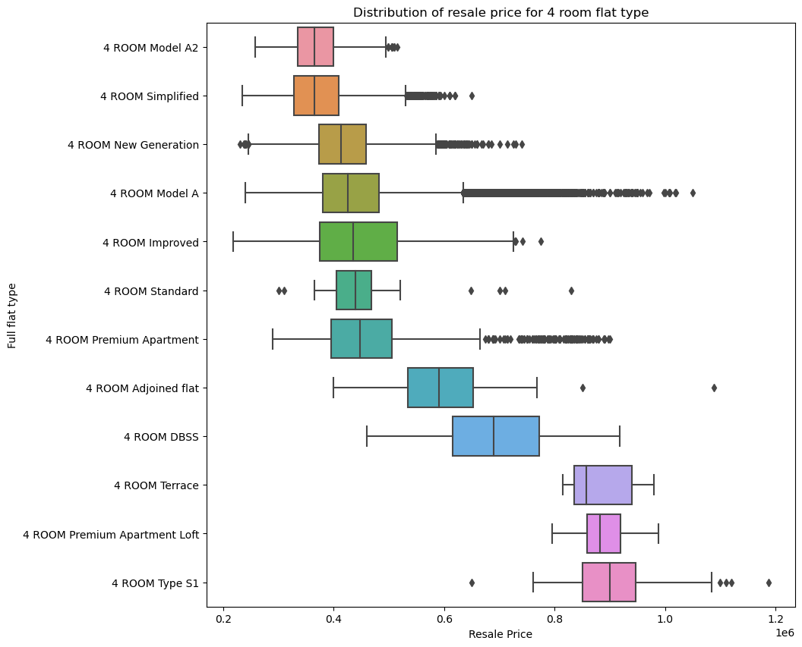
FLAT ATTRIBUTES
LOCATION
AMENITIES
ACCESSIBILITY
A flat’s floor size positively correlates with resale price;
the flat model also shows varying median resale prices
($) ‘000,000
($)
Resale Price ($)
Notes:
We will first start with the flat attributes. Based on the features in the dataset, we can see that a flat’s floor size positively correlates with resale price. In addition, within the same flat type, we can also see that different flat models can also command different resale prices.
floor_area_sqm: 0.656835

Slide 14
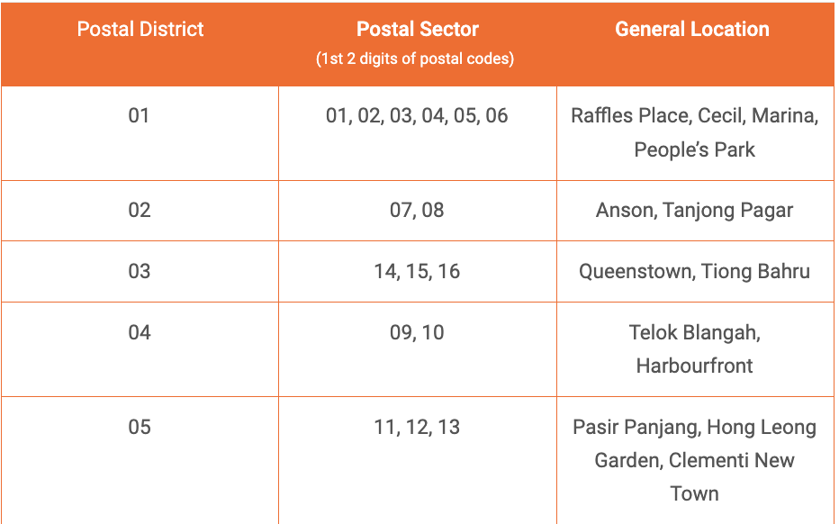
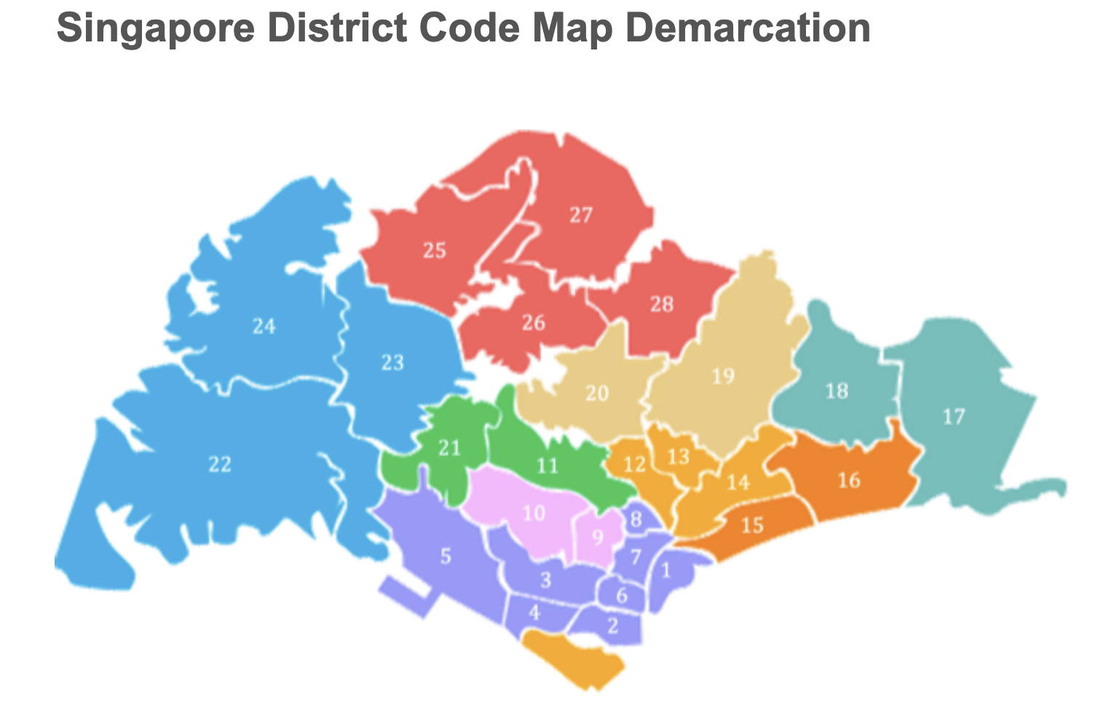

FLAT ATTRIBUTES
LOCATION
AMENITIES
ACCESSIBILITY
Postal information and proximities of flats to Central Business District (CBD) were surfaced as potential factors influencing property prices
Central Business District
Source:
https://dr.ntu.edu.sg/handle/10356/147773
https://www.mingproperty.sg/singapore-district-code/
https://blog.moneysmart.sg/property/rent-singapore-cost-guide/
Notes:
Next, we move on to features related to the location of the flats. From our research, postal district information is used as a key reference point when mentioning property prices in the real estate industry. In addition, there was also academic study on factors affecting the property market where proximities of flats from the CBD were also discussed. These are features which are not found in our original dataset but could be useful in our prediction.
I will now pass the time to Mei Qi who will be sharing more about the features on amenities and accessibility of flats.
LC ends here.

Slide 15
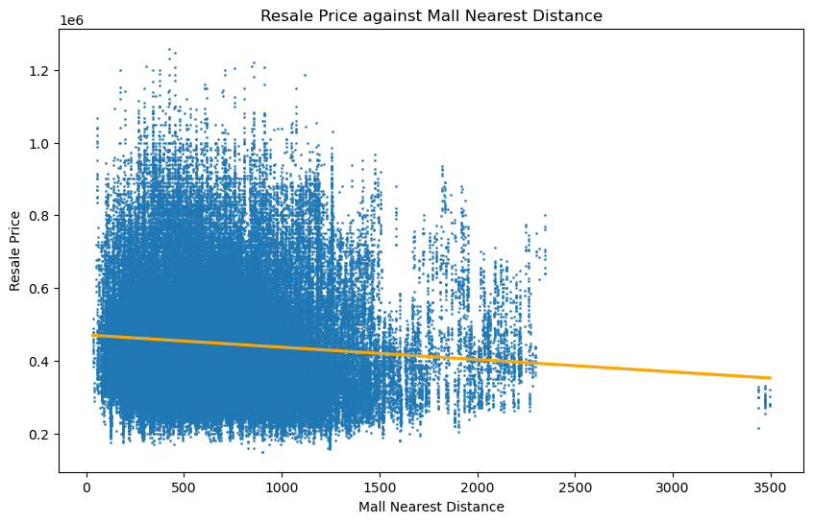
FLAT ATTRIBUTES
LOCATION
AMENITIES
ACCESSIBILITY
Flats located near the Mall have a higher resale price
($) ‘000,000
($)
Potential homeowners looking for relatively cheaper resale flats, but want to have a mall nearby, should avoid Changi
Changi
(m)
Notes:
MQ starts here. having shopping mall around increase price?
Mall nearest distance > 3000m are all located in postal sector = 50, which is in Changi. This indicates that flats in Changi area has no nearby malls. If buyers prioritise having nearby malls around their house, they should avoid the Changi area.

Slide 16
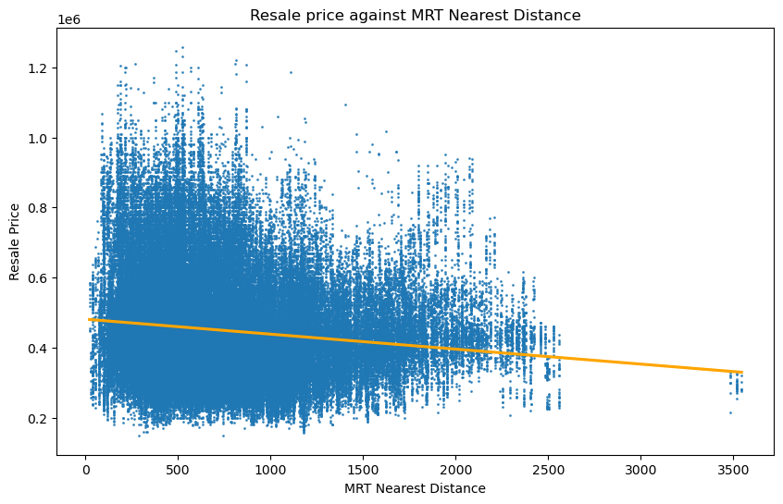
FLAT ATTRIBUTES
LOCATION
AMENITIES
ACCESSIBILITY
Flats located near the MRT have a higher resale price
($) ‘000,000
($)
Potential homeowners looking for relatively cheaper resale flats, but want to have a MRT nearby, should avoid Changi
Changi
(m)

Slide 17




9 Final Features Affecting
Resale Price
FLAT ATTRIBUTES
LOCATION
AMENITIES
ACCESSIBILITY
Year of HDB flat transaction
Floor area of the HDB flat
Age of the HDB flat
Flat model and type of the HDB flat
Storey of the HDB
Postal sector of the HDB flat
Distance of HDB flat from CBD area
Distance of HDB flat from nearest mall
Distance of HDB flat from nearest MRT

Slide 18
Linear Regression Model chosen as it has the best performance and faster runtime than Lasso
Regression Model | Train R² Score (closer to 1 is better) | Test R² Score (closer to 1 is better) | Cross Validation Score (closer to 1 is better) | RMSE (lower is better)
Linear | 0.89 | 0.89 | 0.89 | 48,132
Lasso | 0.89 | 0.89 | 0.89 | 48,132
Ridge | 0.89 | 0.89 | 0.89 | 48,135
Train Score ≈ Test Score: No sign of underfitting and overfitting
Consistent Cross Val score: Model reliability
Using linear regression model, 89% of the variations in resale price can be explained
by our selected features, with ±$48,000 price difference.
RMSE is the measure of the differences between values predicted by a model and the actual values observed
Coefficient of determination, R² is the proportion of the variation in the dependent variable that is predictable from the independent variable(s)
Notes:
The R-squared score of train and test for all models are consistent, indicating no overfitting or underfitting.
The cross-val score is consistent as well, indicating reliability of the model.
As Linear Regression Model has the lowest RMSE, and the fastest runtime, we decide to deploy Linear Regression Model.
MQ END HERE

Slide 19



SCAN HERE FOR CALCULATOR
HDB RESALE PRICE CALCULATOR DEMO
https://dsi39-project2-colony.streamlit.app/

Slide 20
Summary
Problem: The price of HDB resale flats are rising and many are concerned about the finances. To help people better plan for it, there is demand for a HDB resale price calculator.
Result:
9 key features are selected.
A linear regression model built, that is reliable and shows consistent performance across different datasets.
A working web app that is accessible via internet devices
Notes:
Li Cheng starts here.
The methodology for our prediction involves understanding our dataset, which include knowing what are the available features in the data as well as the period of data that we have for the prediction. From the dataset, there were 76 potential features that can help us predict resale price, and the period of data is close to a decade for our analysis.
We also adhered to three main principles for selection of useful features for our modelling, which are 1) including numeric features that show high correlation with resale price, 2) relying on literature review to include features not found in our original dataset, and lastly identifying features with a wide range of values for inclusion in our modelling process.

Slide 21




Moving Forward
IMPROVE PREDICTION SCORE
USER TESTING
PUBLIC LAUNCH
Explore other factors (e.g. impact of cooling measures on resale price)
Explore other machine learning models
Test and improve app usability with focus groups
Campaign launch to educate housing finance planning with calculation.
Phase 1
Phase 2
Phase 3

Slide 22
Thank You

Slide 23
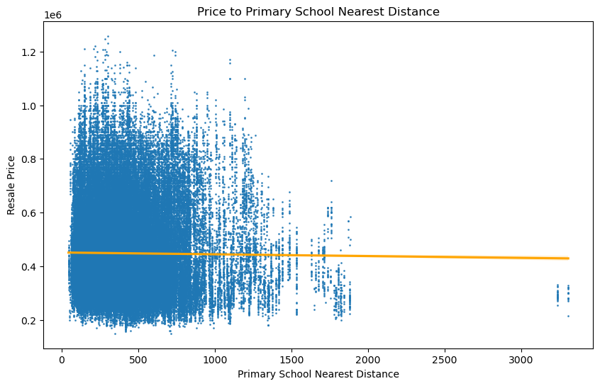
Interesting find: Resale flat price is not affected by nearby primary schools
($) ‘000,000
($)
(m)

